Slide 1
G.723.1 VOICE CODEC
Thanit Noppan
Narisorn Pongpanich
Advisor
Asst.Prof.Dr. Orachat Chitsobhuk

Slide 2
G.723.1 Project Scope for Development
ITU-T G.723.1 Project
  Processes on computer only
  One channel processing
Scope for Development
  Processes on DSP/BIOS board
  Real-time multichannel processing

Slide 3
G.723.1 Project Scope
Algorithm Standard
  Reentrant
  Constant Table
  Algorithm Standard Implementation
Real-time Multichannel Optimization
Library

Slide 4
Algorithm Standard (1)
Reentrant
  Many same algorithm can work concurrently
  Each execution of the program is independent of all other executions

Slide 5
Algorithm Standard (2)
Non-Reentrant
void main( )
{
float in1, in2, out1, out2;
while(data_available)
{
in1 = GetIn1();
out1 = iir(in1);
in2 = GetIn2();
out2 = iir(in2);
}
}
Int x,y;
Float iir(float *in) {
(use variable x,y)
return result;
}

Slide 6
Algorithm Standard (3)
Typedef struct {
int x,y;
} Obj;
Reentrant Support
void main( ) {
Obj obj1,obj2;
float in1, in2, out1, out2;
while(data_available)
{
in1 = GetIn1();
out1 = iir(in1,obj1);
in2 = GetIn2();
out2 = iir(in2,obj2);
}
}
obj1
obj2
Float iir(float *in,Obj *p) {
p->x;
p->y;
return result;
}

Slide 7
Algorithm Standard (4)
Constant Table
  Define in one structure
  Assign value as global pointer and threat as read only value

Slide 8
Algorithm Standard (5)
Constant Table
Typedef struct {
float lpc[4];
int ind[6];
int coef[2];
} table,*table_ptr;
table Table = {
{0.23,2.43,2.34,1.34},
{2,3,1,5,4,6},
{4,5}
};
Table_ptr TABPTR;
TABPTR = &Table;

Slide 9
Algorithm Standard (6)
Algorithm Standard Implementation
  API function and Module Specific function example
API function
Module Specific function
algAlloc
algActivate
encode
algControl
algDeactivate
algFree
algInit
algMoved
algNumAlloc

Slide 10
Algorithm Standard (7)
API function sequence
algAlloc
algInit
algActivate
start state
algMoved
real-time states
‘process’
terminal state
algFree
algDeactivatec

Slide 11
Algorithm Standard (8)
Algorithm Standard Implementation
  Make V-table (table contain function used by module)
Application
implements
G.723.1 Encoder
Implemetation
calls

Slide 12
Real-time Multichannel Optimization (1)
G.723.1 Block Diagram
Input
Filtering
LPC
LSP
Pitch Search
Adaptive Codebook Search
Output
+
Fixed Codebook Search (MPMLQ/ACELP)

Slide 13
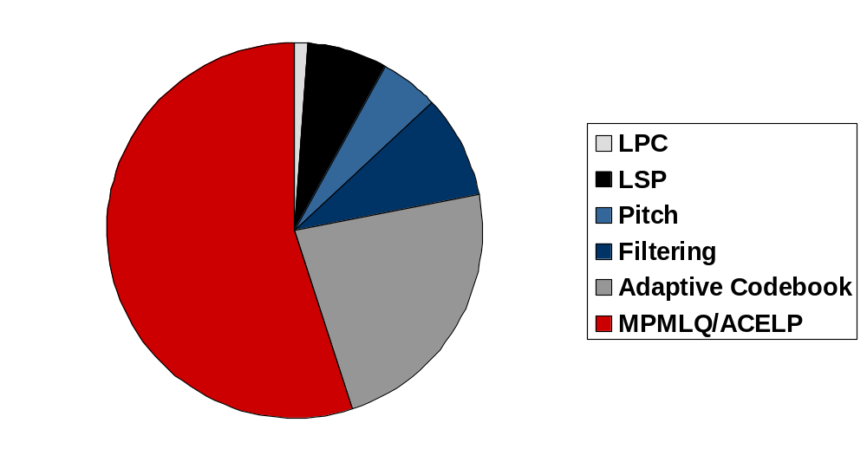
Real-time Multichannel Optimization (2)
1%
7%
5%
9%
55%
23%

Slide 14
Real-time Multichannel Optimization (3)
ACELP (rate 5.3 kbit/s) Optimization
  Candidate Scheme for Fast ACELP Search
MP-MLQ (rate 6.3 kbit/s) Optimization
  Odd-indexed Autocorrelation Removed
  Instruction and Hardware Acceleration for MP-MLQ
  The Access Rate of Candidate for Gain

Slide 15
Real-time Multichannel Optimization (4)
ACELP (rate 5.3 kbit/s) Optimization
  Candidate Scheme for Fast ACELP Search
  9.54 % complexity reducing
before
sign
positions
frame
8 regions Codebook
Search
indices
±
0, 8, 16, 24, 32, 40, 48, 56
±
2, 10, 18, 26, 34, 42, 50, 58
after
K region(s) Codebook
Search
indices
±
4, 12, 20, 28, 36, 44, 50, 60
frame
±
6, 14, 22, 30, 38, 46, 54, 62

Slide 16
Real-time Multichannel Optimization (5)
MP-MLQ (rate 6.3 kbit/s) Optimization
  Odd-indexed Autocorrelation Removed
  1.67 % complexity reducing
before
Impulse response
Impulse Response
Autocorrelation calculation
after
Even Impulse response only
Impulse Response
Autocorrelation calculation

Slide 17
Real-time Multichannel Optimization (6)
MP-MLQ (rate 6.3 kbit/s) Optimization
  Instruction and Hardware Acceleration for MP-MLQ
    To reduce the number of multiplication
    Excluding multiplication with zeros
  14 % complexity reducing

Slide 18
Instruction and Hardware acceleration for MP-MLQ
for (j=0; j < SubFrLen; j++)
OccPos[j] = (FLOAT)0.0;
for (j=0; j < Np; j++)
OccPos[Temp.Ploc[j]] = Temp.Pamp[j];
for (l=SubFrLen-1; l >= 0; l--) {
Acc0 = (FLOAT)0.0;
for (j=0; j <= l; j++)
Acc0 += OccPos[j] * Imr[l-j];
OccPos[l] = Acc0;
}
G.723.1 Error Vector
Calculation
O(n²)
Several multiplication
with zero
Forcing the inner loop
to multiply over all OccPos

Slide 19
Instruction and Hardware acceleration for MP-MLQ
for (l=SubFrLen-1; l >= 0; l--) {
Acc0 = (FLOAT)0.0;
for (j=0; j < Np; j++) {
if ( l-Temp.Ploc[j] >=0 )
Acc0 += OccPos[j]*Imr[l-j];
}
OccPos[l] = Acc0;
}
Error Vector Calculate
Implementation
O(n)
Loop over the non-zero values

Slide 20
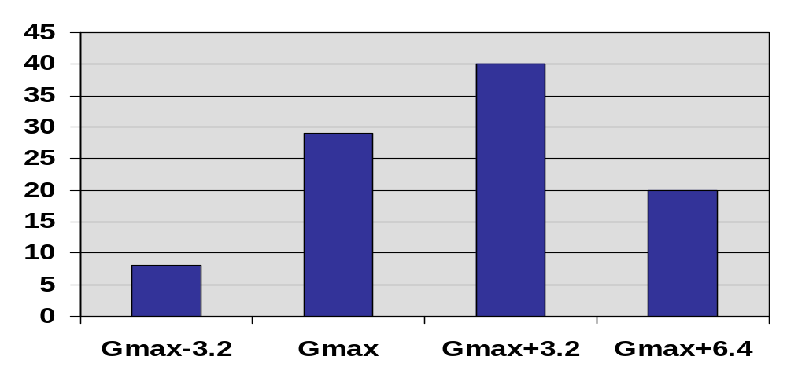
Real-time Multichannel Optimization (7)
MP-MLQ (rate 6.3 kbit/s) Optimization
  The Access Rate of Candidate for Gain
  18 % complexity reducing

Slide 21

The Access Rate of Candidate for Gain
before
– 3.2 ,
Pitch Gain
(G_{max})
Pitch Gain Quantized
+3.2 ,
+ 6.4
Minimum Error Computation
Selected
after
Pitch Gain
(G_{max})
Pitch Gain Quantized
+3.2

Slide 22

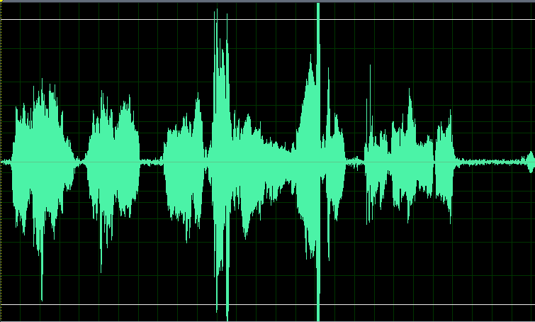
Real-time Multichannel Optimization (8)
ACELP (rate 5.3 kbit/s) Optimization
before (7.76 ms/channel)
after (7.02 ms/channel)
stop

Slide 23
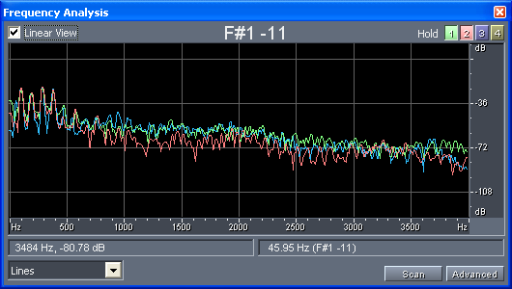
Real-time Multichannel Optimization (9)
ACELP (rate 5.3 kbit/s) Optimization
Input
Before
After
stop

Slide 24
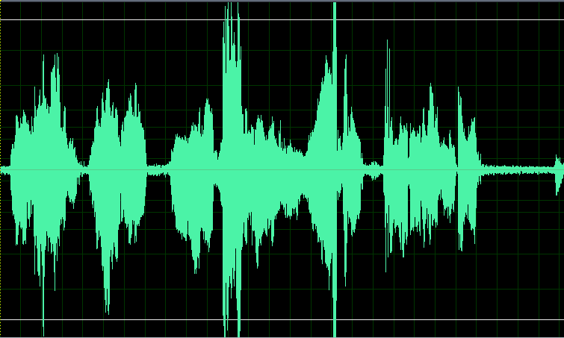

Real-time Multichannel Optimization (10)
MP-MLQ (rate 6.3 kbit/s) Optimization
before (10.20 ms/channel)
after (7.10 ms/channel)
stop

Slide 25
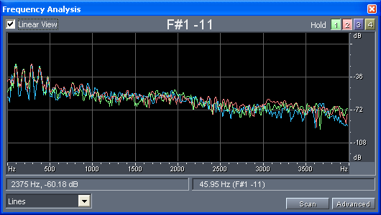
Real-time Multichannel Optimization (11)
MP-MLQ (rate 6.3 kbit/s) Optimization
Input
Before
After
stop

Slide 26
Library
g723enc.l67
Contain interface
LPC2.c
g723enc_ti.l67
EXC2.h
LPC2.c
Contain algorithm
EXC2.c
  To combine many algorithm file to a few library file
  Don’t need to distribute source code to user

Slide 27
Conclusion
G.723.1 Algorithm Standard
G.723.1 Real-time Multichannel
G.723.1 Library

Slide 28
Q & A
Thank You

Slide 29

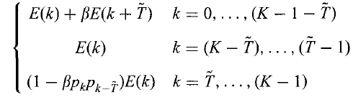

Candidate scheme for fast ACELP search
Pilot function
Condensing function

Slide 30
Odd-indexed Autocorrelation Removed
for (l=k; l < SubFrLen; l +=Sgrid)
{
if (OccPos[l] != (FLOAT)0.0)
continue;
Acc0 = WrkBlk[l] - Temp.Pamp[j-1]* ImrCorr[abs(l-Temp.Ploc[j-1])];
}

Slide 31
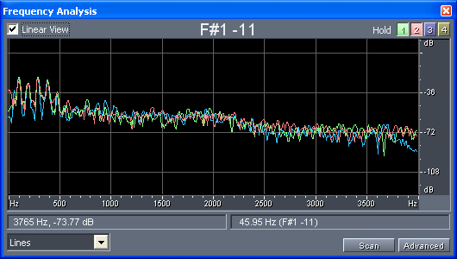
Real-time Multichannel Optimization (1)
Comparison of ACELP and MP-MLQ Optimization
Input
ACELP
MP-MLQ
stop

Slide 32
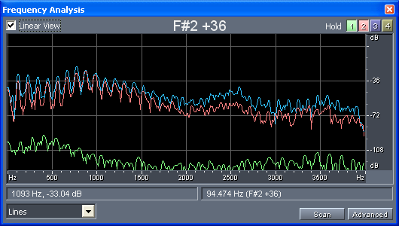
Real-time Multichannel Optimization (2)
ACELP Optimization for codec 10 times
Input
1st
10th
stop

Slide 33
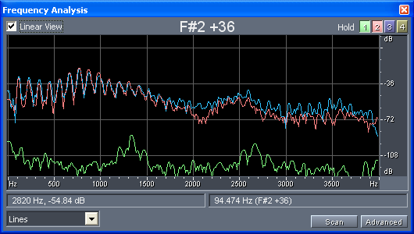
Real-time Multichannel Optimization (3)
MP-MLQ Optimization for codec 10 times
Input
1st
10th
stop

Slide 34
G.723.1 vs G.729 Comparision (1)
Features | Standard
 | G.723.1 | G.729
Standardized by | ITU-T | ITU-T
Description | Dual rate speech coder for multimedia (part of H.324) ACELP / MP-MPQ | Speech coder CS-ACELP
Bit Rate (kbit/s) | 5.3 / 6.3 | 8
Sampling Rate (kHz) | 8 | 8
Frame Delay (ms) | 30 | 10

Slide 35
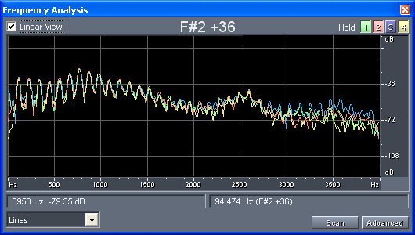
G.723.1 vs G.729 Comparision (2)
Input and 1st Compression
Input
G723.1
ACELP
G723.1
MP-MLQ
G729
stop

Slide 36
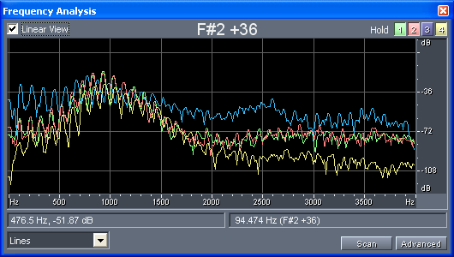
G.723.1 vs G.729 Comparision (3)
Input and 10st Compression
Input
G723.1
ACELP
G723.1
MP-MLQ
G729
stop

Slide 37
TMS320C6713
Specification
  225 MHz floating point DSP
  Execute up to eight 32 bit instructions per cycle
  32 general purpose registers of 32 bit word length
  Eight functional units

Slide 38
Functional block and CPU diagram
2 Datapath process concurrently
VLIW core (allow 8 instruction to be issue in a single clock)
Schedule by compiler
Instruction Fetch
Control
Register
Instruction Dispatch
Control
Logic
Instruction Decode
Data Path A
Data Path B
Interrupt control
Register File A
Register File B
Functional Unit

